Slide 1
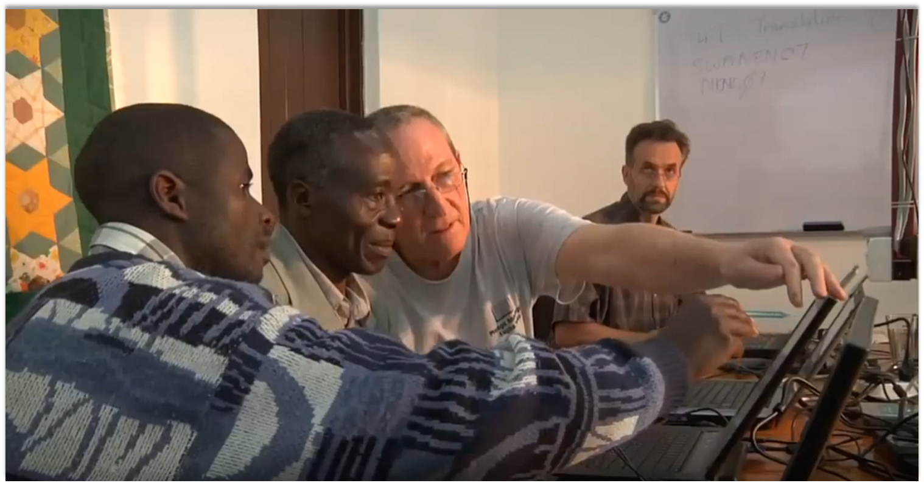
For this commandment that I am commanding you today is not too hard for you, neither is it too far for you to reach. It is not in heaven, so that you should have to say, 'Who will go up for us to heaven and bring it down to us and make us able to hear it, so that we may do it?' Neither is it beyond the sea, so that you should have to say, 'Who will go over the sea for us and bring it to us and make us to hear it, so that we may do it?' But the word is very near to you, in your mouth and your heart, so that you may do it (Deut. 30:11-14).
Wycliffe Associates
Introduction
All Scripture taken from the English Unlocked Literal Bible (ULB), ©2017, 2022 Wycliffe Associates, Available at https://bibleineverylanguage.org/translations, licensed under the Creative Commons Attribution-ShareAlike 4.0 International License.
The English ULB is based on the unfoldingWord® Literal Text, CC BY-SA 4.0. The original work of the unfoldingWord® Literal Text is available at https://unfoldingword.bible/ult/.

Slide 2
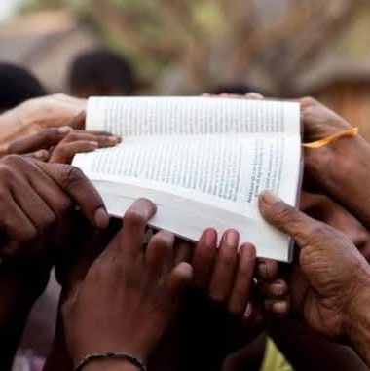
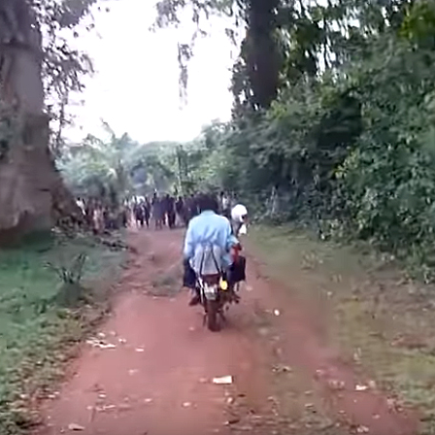
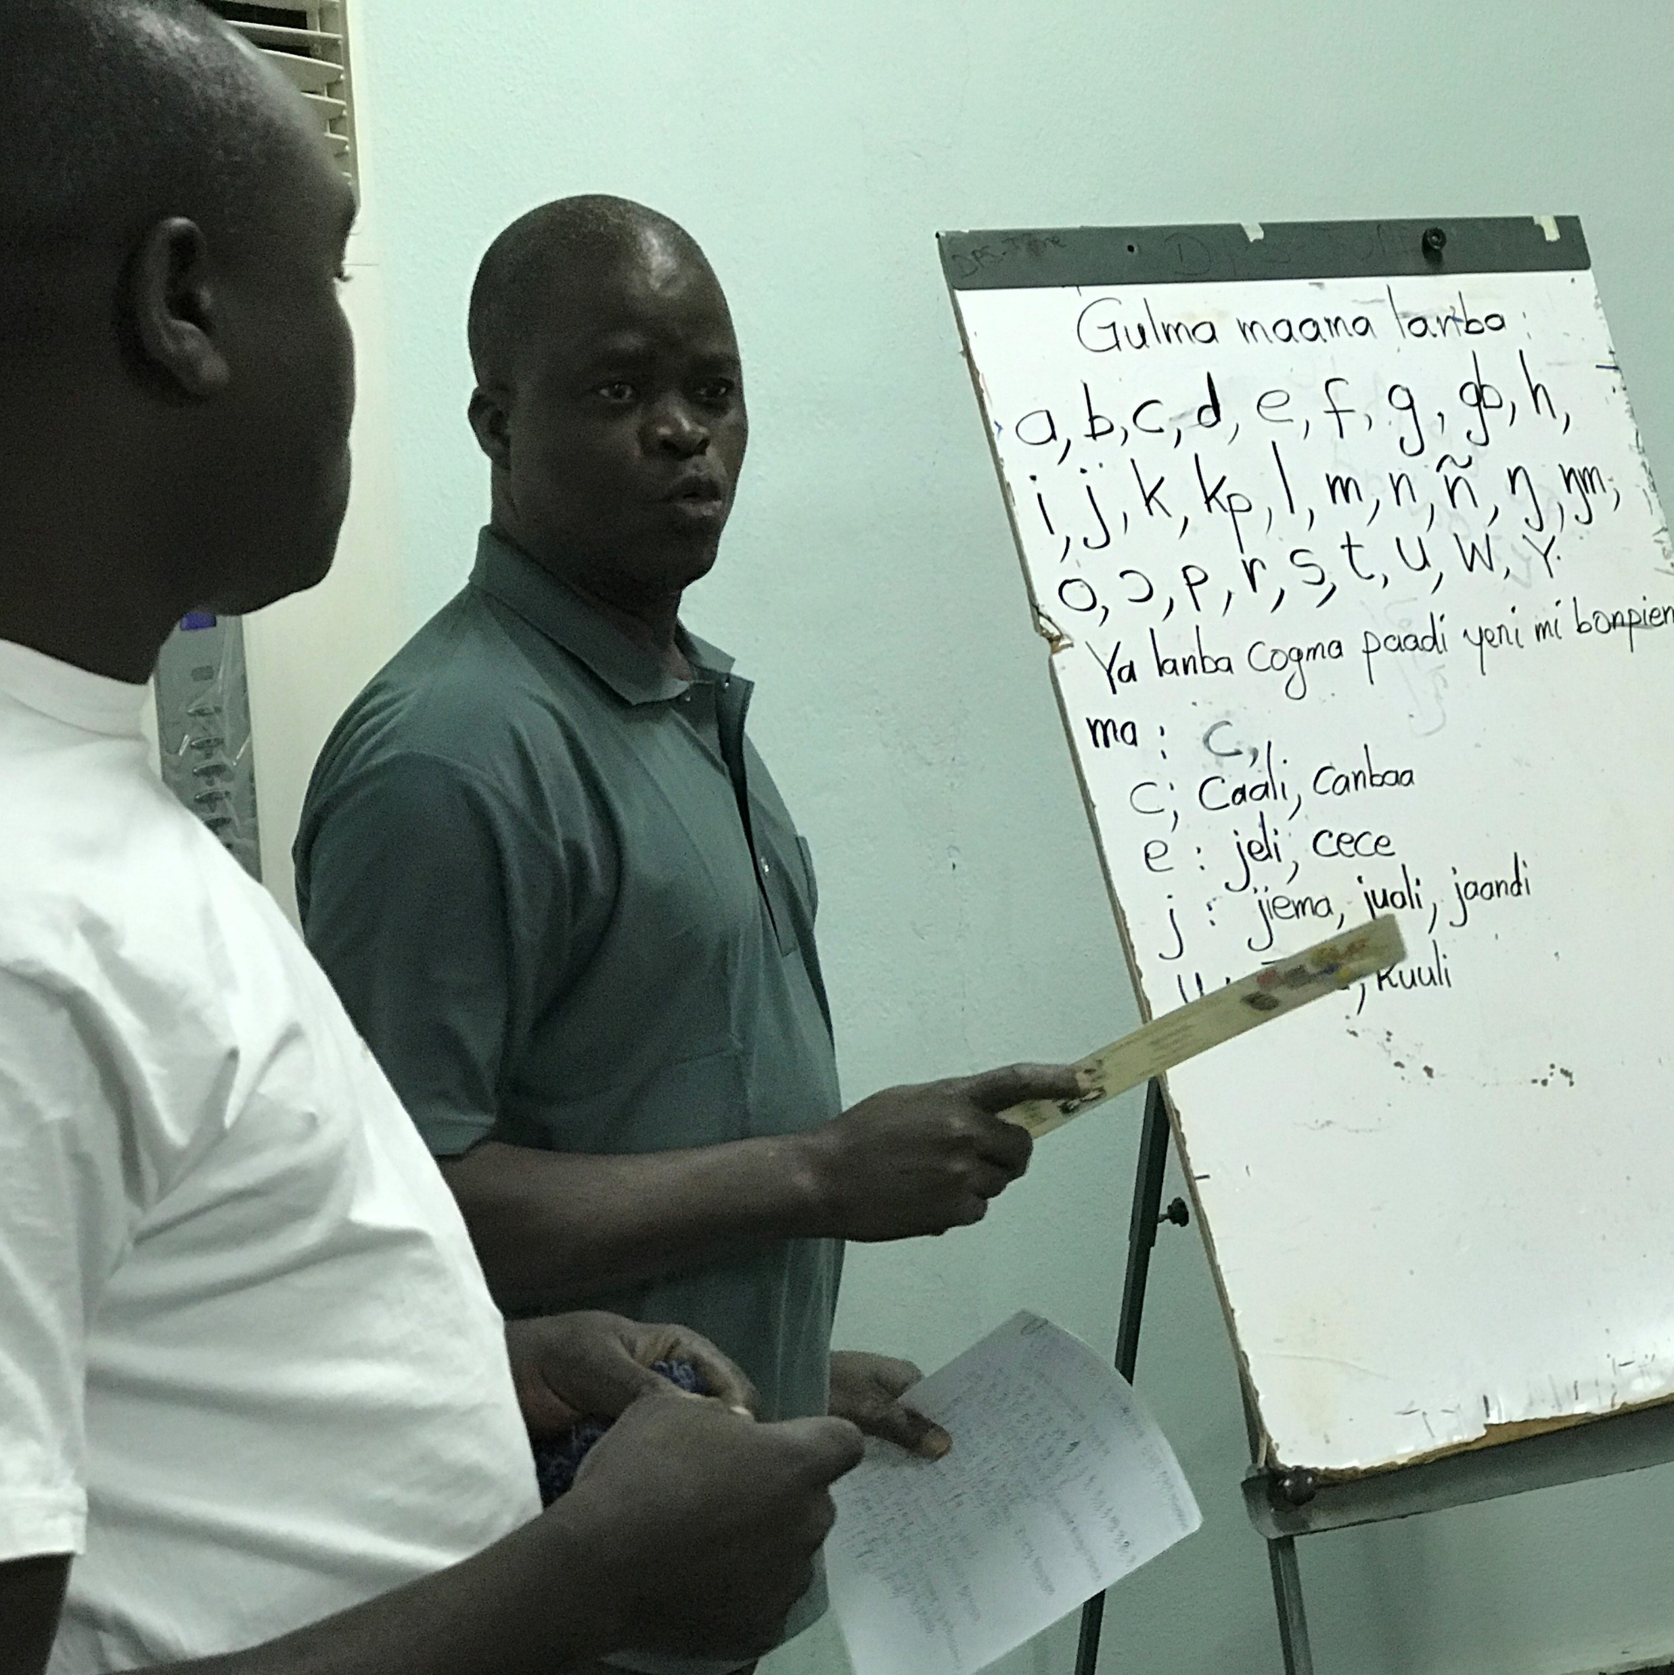
?

Slide 3
Wycliffe Associates History Why?
Wycliffe Associates was established in 1967
Purpose was to provide practical assistance to translators globally
Allowed Translators to focus on Bible translation work

Slide 4
Wycliffe Associates History How?
Volunteers offered a wide range of skills to assist Bible translation work globally
Administration
Construction
Maintenance
Technology
Infrastructure
Translators could focus on Bible translation rather than other activities

Slide 5
Wycliffe Associates History Urgent Need Called for a New Solution
In 2014, Wycliffe Associates developed and tested a new Bible translation method
Wycliffe Associates’ 8-Step Translation Process
The 8-Step process equips national translators to quickly translate the Bible clearly and accurately
The local church has a central role

Slide 6

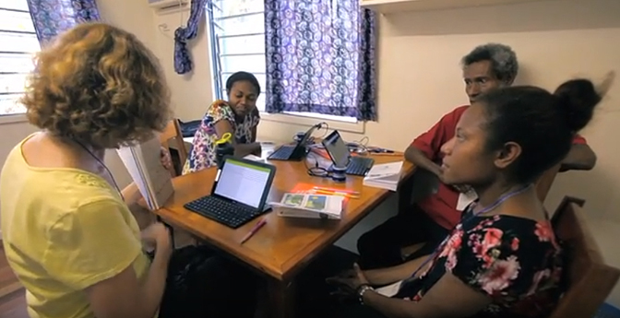
2014
First 8-Step translation event
Mother-tongue translators trained in this new method

Slide 7

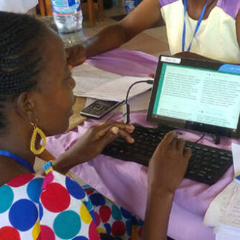

Focus shifted to training translators in the 8-Step method
Now providing free, open-license resources to translators around the world

Slide 8

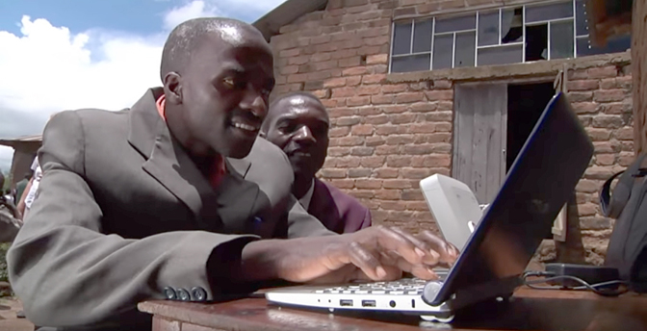
VISION:
A Bible in Every Language
Advancing Church-Owned Bible Translation through free training and tools
2 Corinthians 9:6–15
Matthew 28:19–20

Slide 9
2 Corinthians 9:6-15 (ULB)
The point is this: The one who sows sparingly will also reap sparingly, and the one who sows for the purpose of a blessing will also reap a blessing. ⁷ Let each one give as he has planned in his heart, not reluctantly or under compulsion, for God loves a cheerful giver. ⁸ And God is able to make all grace overflow for you, so that always, in all things, you may have all you need. This will be so that you may multiply every good deed. ⁹ It is as it is written: "He has distributed his riches and given them to the poor.
His righteousness lasts forever."

Slide 10
2 Corinthians 9:6-15, continued
¹⁰ He who supplies seed to the farmer who sows and bread for food will also supply and multiply your seed for sowing. He will increase the harvest of your righteousness. ¹¹ You will be enriched in every way so you can be generous. This will bring about thanksgiving to God through us. ¹² For carrying out this service not only meets the needs of God's holy people, but it also is overflowing into many acts of thanksgiving to God. ¹³ Because of your being tested and proved by this service, you will also glorify God by obedience to your confession of the gospel of Christ. You will also glorify God by the generosity of your contribution to them and to everyone. ¹⁴ They long for you, and they are praying for you. They do this because of the very great grace of God that is on you. ¹⁵ May thanks be to God for his inexpressible gift!

Slide 11
Matthew 28:19-20 (ULB)
¹⁹ Go therefore and make disciples of all the nations. Baptize them into the name of the Father, of the Son, and of the Holy Spirit. ²⁰ Teach them to obey all the things that I have commanded you. See, I am with you always, even to the end of the age."

Slide 12
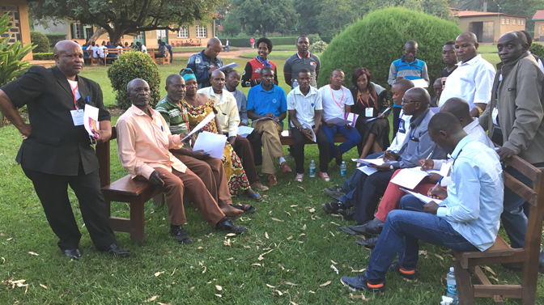
We are committed to serving the local church. We are partnering to reach every language with Bible translation.

